Slide 1
Assalamuyalaikum Everyone
Today I will show my Web-Development Project. Hope everyone will see.
Sub : Web-Development
Day : Wednesday
Time : 8:45am

Slide 2
PSYCHOLOGY KNOWLEDGE
Web-development Project Presentation
Psychology is the scientific study of mind and behavior. Psychology includes the study of conscious and unconscious phenomena, including feelings and thoughts. It is an academic discipline of immense scope, crossing the boundaries between the natural and social sciences. Psychologists seek an understanding of the emergent properties of brains, linking the discipline to neuroscience. As social scientists, psychologists aim to understand the behavior of individuals and groups.

Slide 3
Project features
Web-development Project Presentation
Disciplinary organization
Motivational Facts
Psychological Facts
Color Themes
Research methods
IQ Level Test
References

Slide 4
Included languages
Web-development Project Presentation
HTML --- Hyper Text Markup Language
CSS --- Cascading Style Sheets
JS --- JavaScript
Bootstrap
PHP --- Hypertext Preprocessor
MySql --- Structured Query Language.

Slide 5
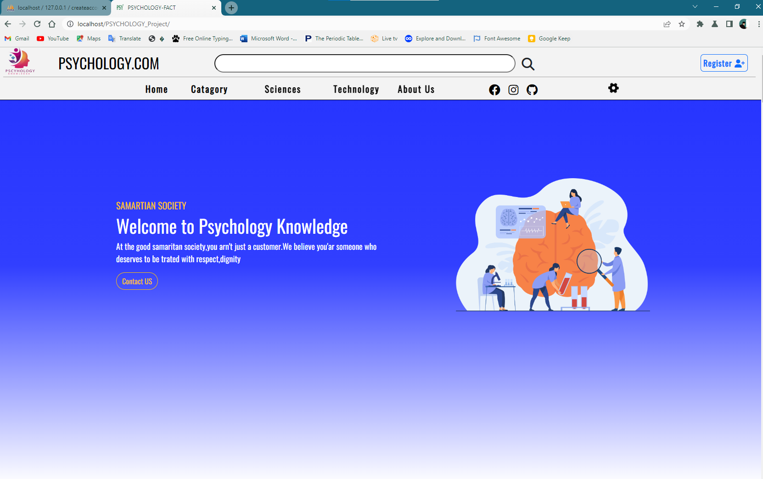
My Website Interface
Web-development Project Presentation

Slide 6
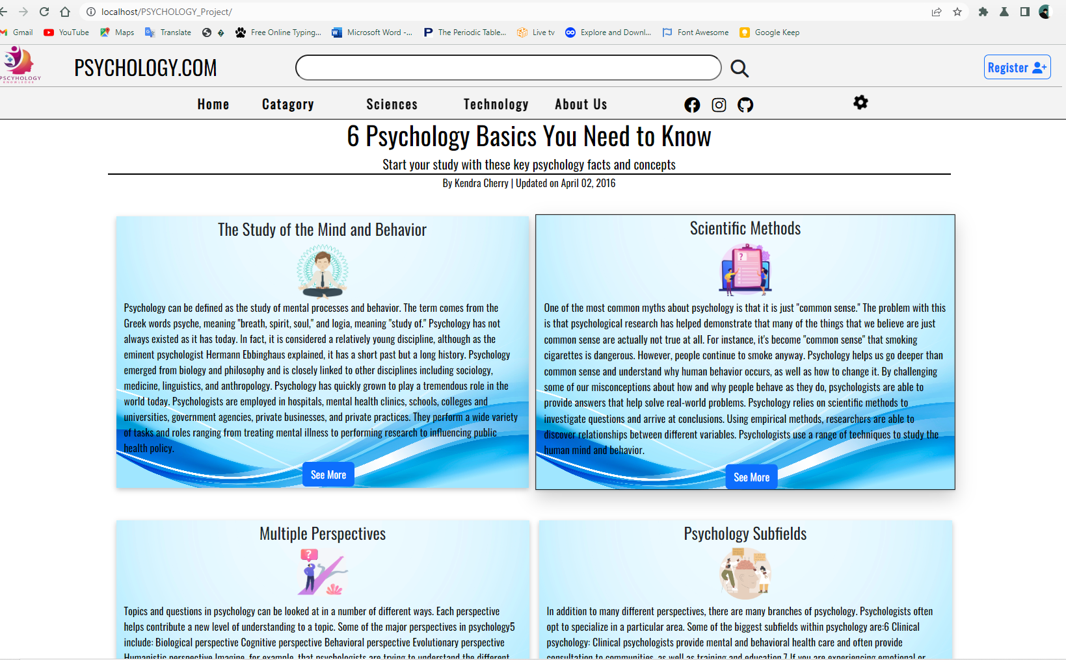
One Of The Section
Web-development Project Presentation

Slide 7
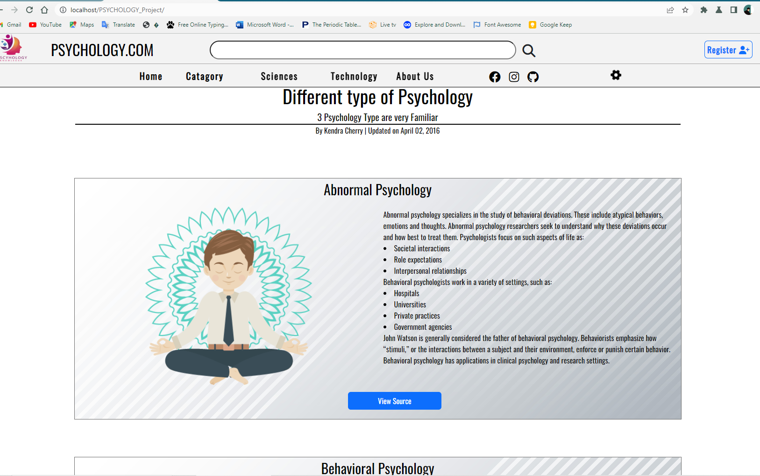
Another Section
Web-development Project Presentation

Slide 8
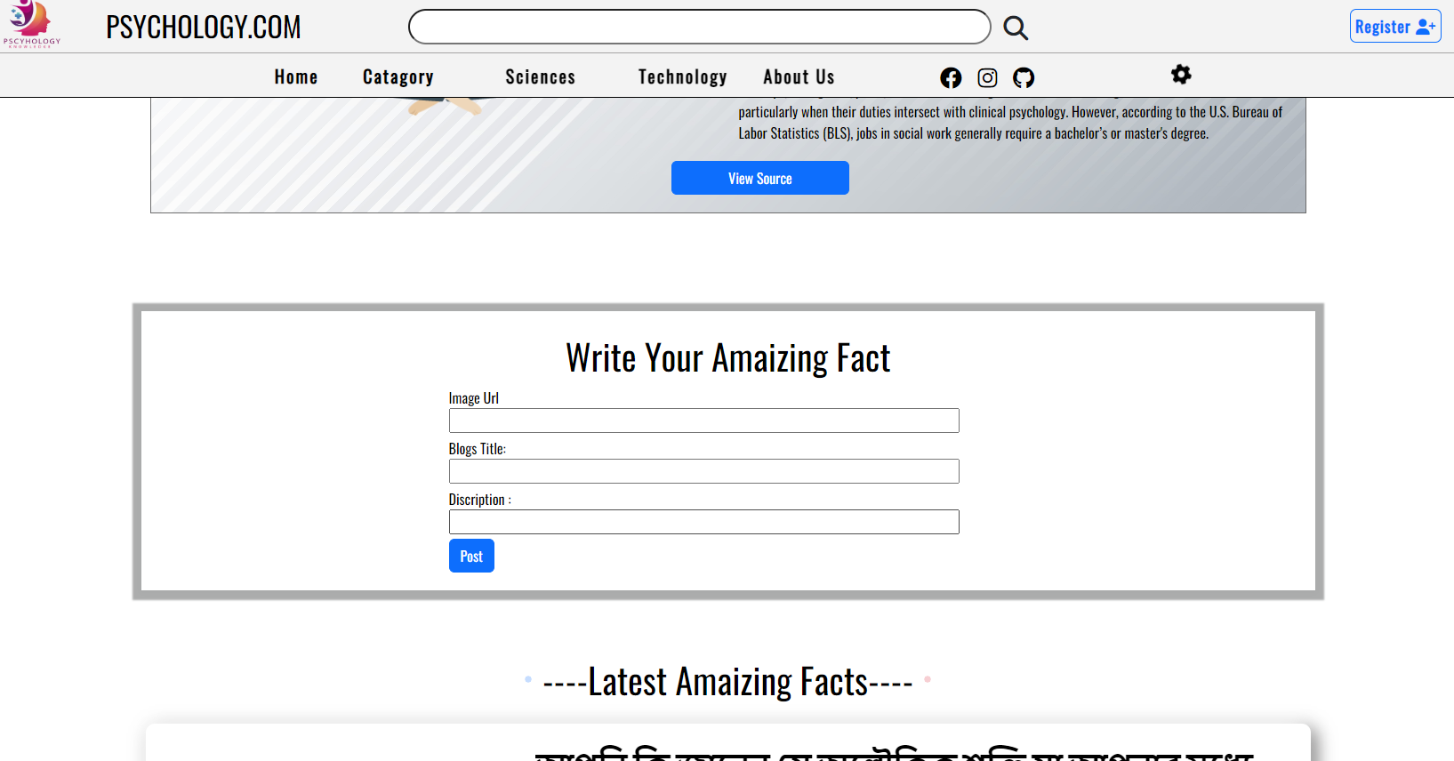
Write A Post Section
Web-development Project Presentation

Slide 9
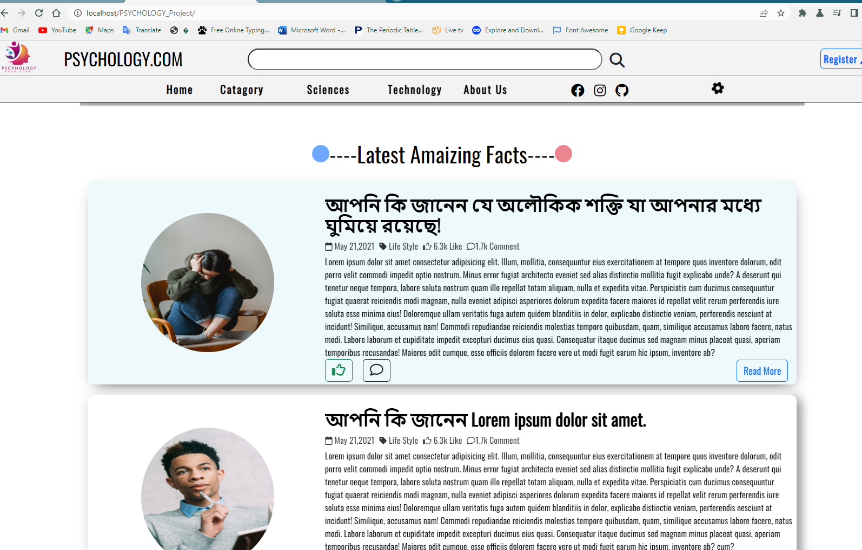
Various Blog
Web-development Project Presentation

Slide 10
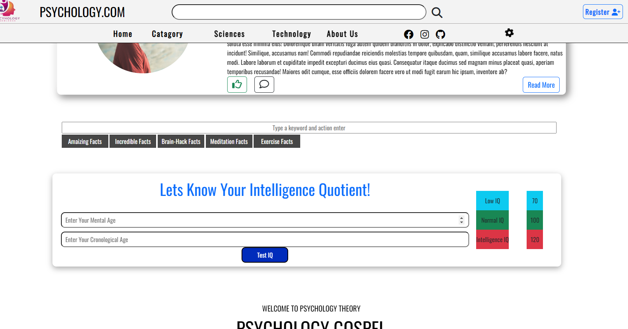
IQ Level Test Section
Web-development Project Presentation

Slide 11
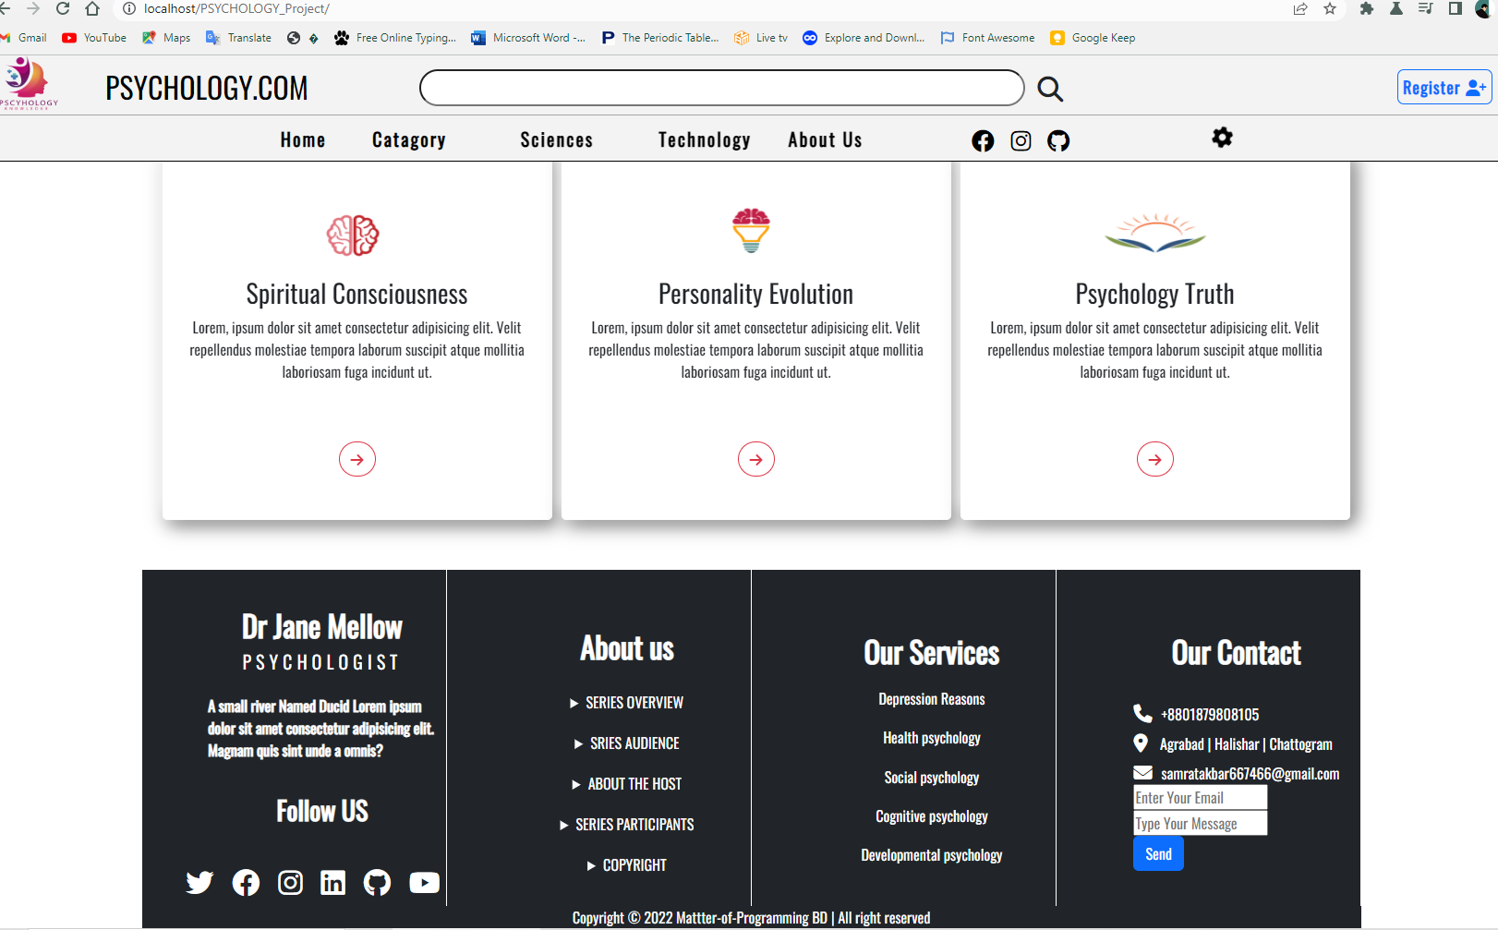
Footer Section
Web-development Project Presentation

Slide 12
Web-development Project Presentation
Thank you Everyone to give me chance for Presentation. Assalamuyalaikum!
GOOD BYE

